Slide 1

Impact of COVID-19 on Insurance Sales: A Data-Driven Approach to Revitalize the Business of a Senior LIC Agent
Presented by:
Pavan Kumar K N
21f1004929

Slide 2
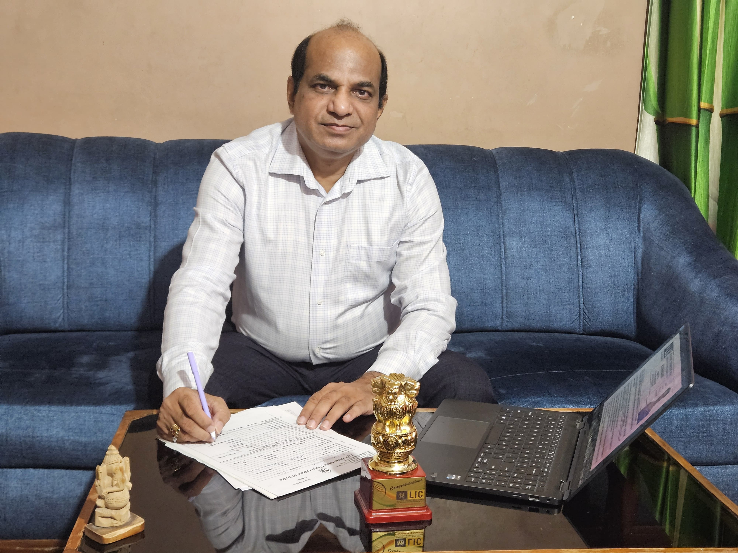
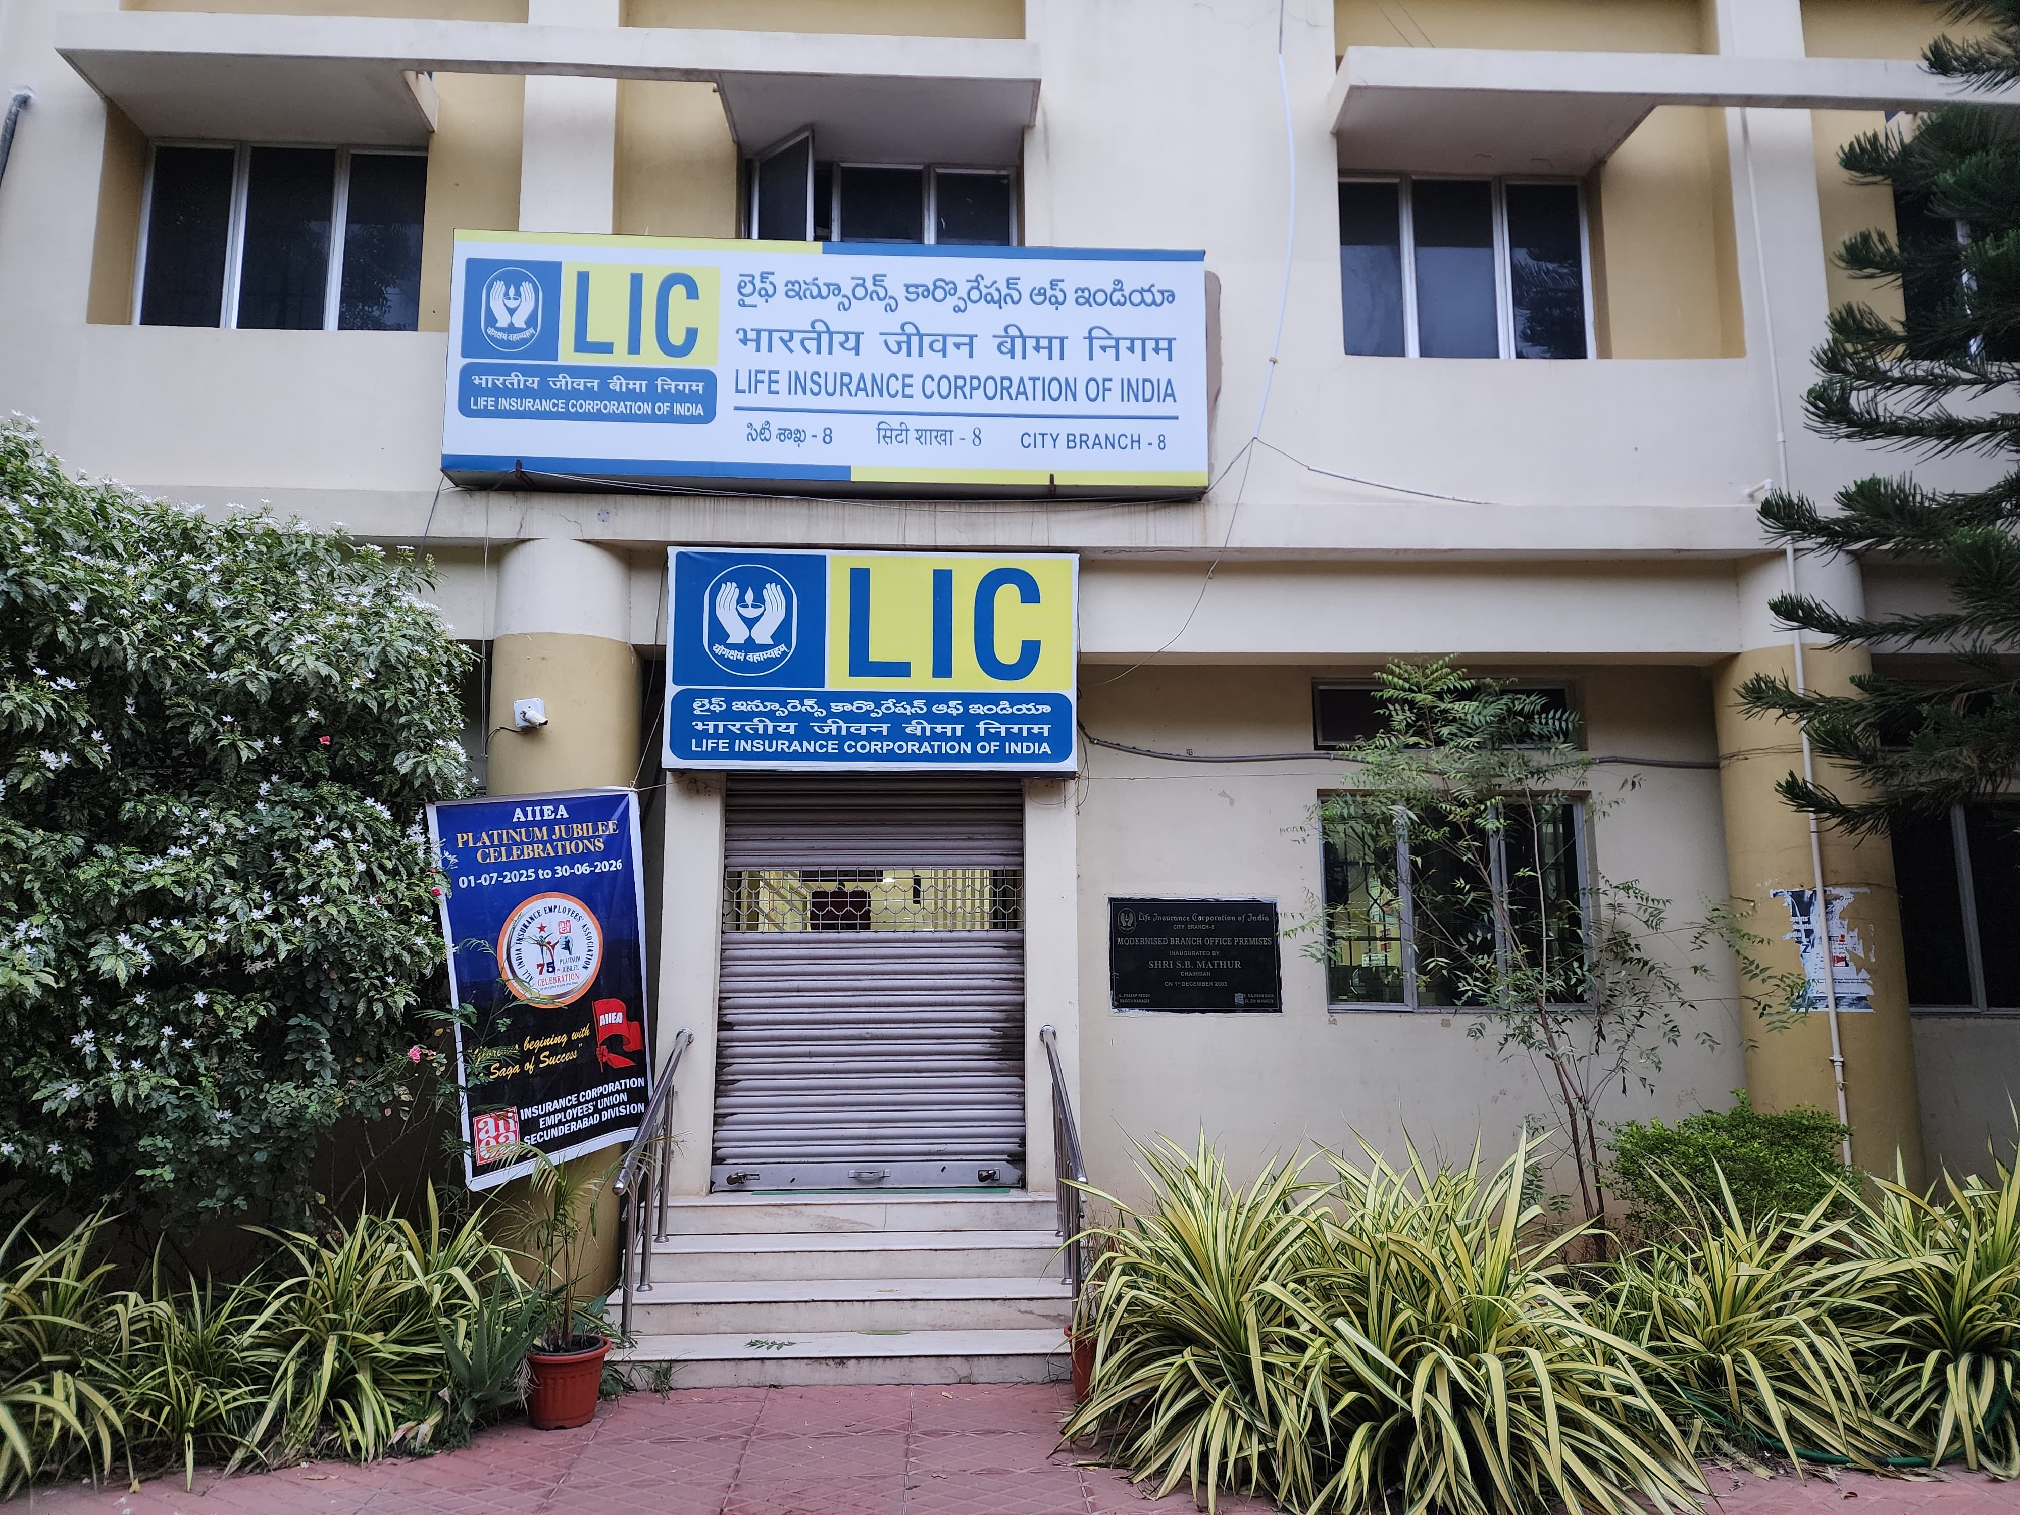
Overview of the Business
Nature of Business: Mr. K R Naveen Kumar, a life Insurance provider focusing on diverse plans (term, endowment, money-back, etc.).
Market Position: Established presence in the regional market with steady growth before 2020.
Challenge: Decline in policy sales and sum assured post COVID-19.
Goal: Understand sales patterns, identify influencing factors, and recommend data-backed strategies.

Slide 3
Problem Statements
Problem Statement 1:
There has been a consistent decline in policy sales and total sum assured for Mr. K R Naveen Kumar post-COVID, indicating a shift in customer behavior.
Problem Statement 2:
There is limited understanding of how demographic or behavioral changes in customers since 2010 have influenced sales trends.

Slide 4
Dataset Overview and Descriptive Statistics
Source: Organizational internal sales records (2010–2024).
Key Columns:
Date of Commencement, Financial Year
Sum Assured, Payment Mode, Premium, Annual Adjusted Premium
Table-Term, Plan No, Policy Name, SA Segment
Volume: Thousands of policies over 14 years.
Tools Used: Excel
STATISTIC | SUM ASSURED | ADJUSTED ANNUAL PREMIUM
Mean (Average) | ₹ 4,21,116.11 | ₹ 65,317.22
Median | ₹ 3,00,000.00 | ₹ 39,240.00
Standard Deviation | ₹ 4,66,732.04 | ₹ 93759.92
Minimum | ₹ 20,000.00 | ₹ 1,852.00
Maximum | ₹ 70,00,000.00 | ₹ 10,18,000.00
Range | ₹ 69,80,000.00 | ₹ 10,16,148.00
25th Percentile (Q1) | ₹ 2,00,000.00 | ₹ 23,118.00
75th Percentile (Q3) | ₹ 5,00,000.00 | ₹ 70,548.00
Descriptive Statistics
Subset of Dataset

Slide 5
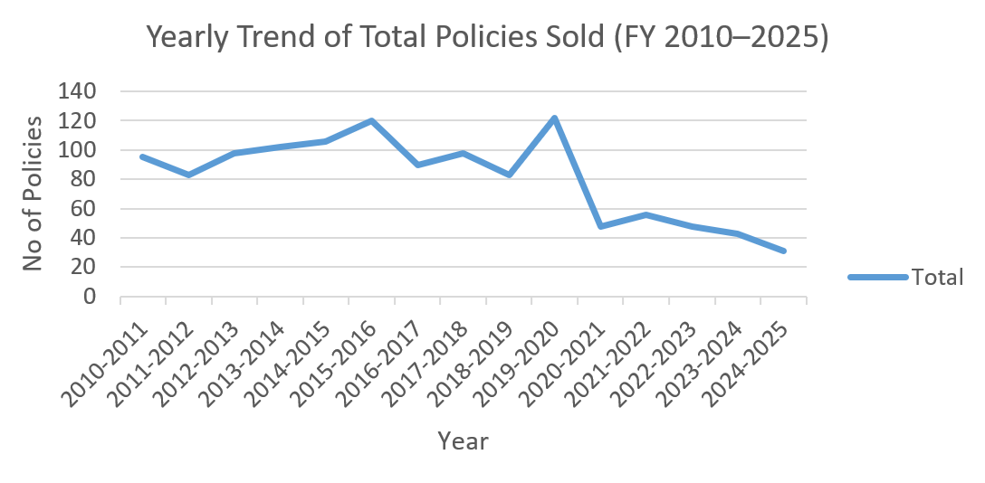
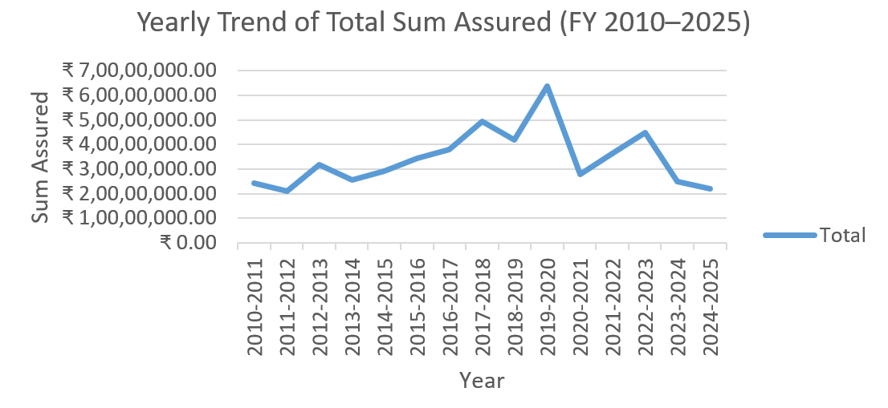
Key Findings
Yearly Trend of Total Policies Sold (Line Graph)
Overall decline in policy sales observed post-COVID.
Peak in sales around 2019–2020, followed by a gradual reduction.
Indicates changing customer demand and possible external factors such as pandemic, economy.
Yearly Trend of Total Sum Assured (Line Graph)
Sum assured grew steadily till 2017–2018, then fluctuated.
Drop after 2020 highlights reduced customer investment confidence.
Reflects both volume and value impact of sales decline.

Slide 6
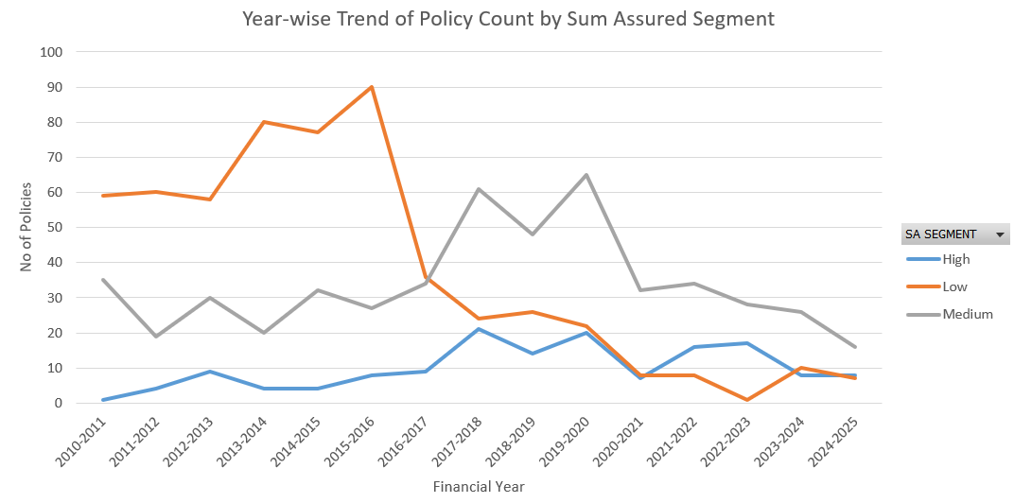
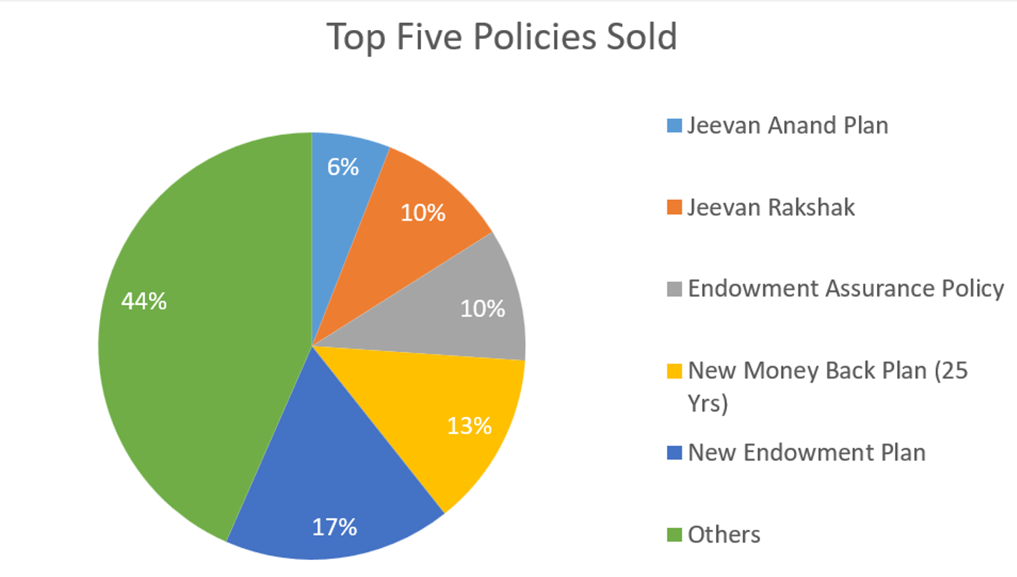
Key Findings
Yearly Trend of Policy Count by Sum Assured Segment (Line Graph)
Low SA policies dominate in count, though declining in recent years.
High SA policies remain fewer but show resilience.
Customer preference shifting towards affordable/low-risk products.
Top Five Policies Sold (Pie Chart)
A few policies contribute majority of sales.
New Endowment Plan and New Money Back Plan (25 Years) account for the largest share.
Highlights dependence on limited product range. Therefore, risk of sales concentration.

Slide 7
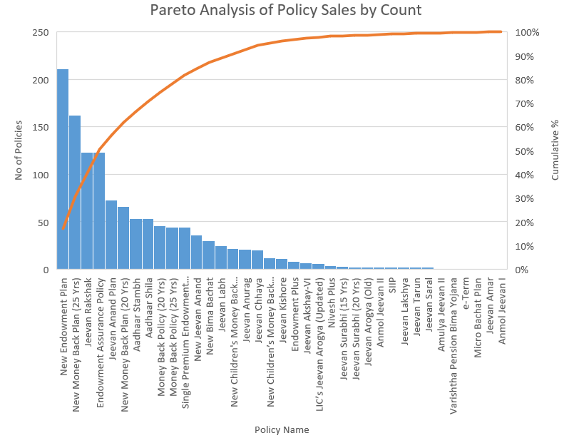
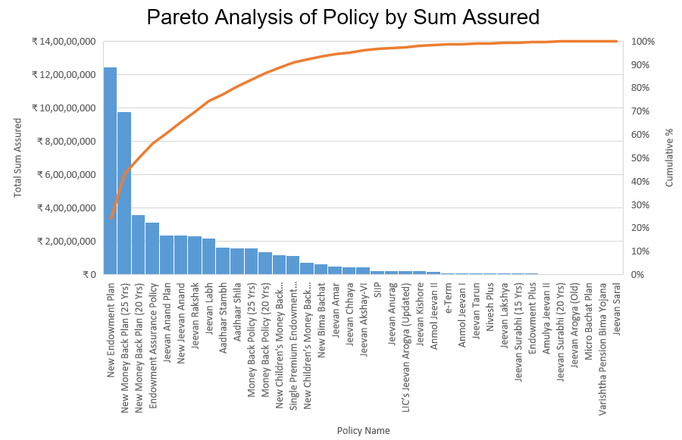
Key Findings
Policy Sales by Count (Pareto Chart)
~20% of policies contribute to ~80% of total policy count.
Indicates a “vital few” policies dominate customer preference.
Opportunity to optimize resources by focusing on these.
Policy Sales by Sum Assured (Pareto Chart)
Few policies generate the majority of sum assured value.
Concentration risk but also scope to push these products strategically.
Confirms imbalance in sales contribution across product portfolio.

Slide 8
Recommendations
1. Enhance Customer Data & Insights
Collect demographic/behavioral data via forms and digital channels.
Enables segmentation, predictive modeling, and personalized offerings.
2. Focus on High-Contributing Policies (Class A)
Prioritize Class A policies with more marketing, training & cross-sell.
Add loyalty programs to expand customer value.
3. Improve Retention & Renewals
Rewards for multi-year renewals.
Initiate Automated reminders and seamless online renewals.

Slide 9
Recommendations
4. Targeted Marketing by SA & Payment Segment
Segment into High SA–Annual, High SA–Frequent, Low SA–Annual, Low SA-Frequent.
Premium positioning for High SA, micro-insurance for Low SA.
5. Predictive Analytics & Forecasting
Use time-series models to forecast demand.
Churn prediction models to retain at-risk customers.
Cluster analysis for hidden customer segments.
6. Continuous Monitoring & Feedback Loop
Dashboard for KPIs (sales, renewals, SA mix, satisfaction).
Collect customer/agent feedback for agile product & training updates.

Slide 10
Thank You

